Slide 1


Aws AUTOSCALING AND LOAD BALANCING
Presented By Arit Kar
-
-

Slide 2

Content
Introduction of autoscaling
Importance of autoscaling
How autoscaling works
Types of autoscaling
Introduction of loadbalancing
Importance of loadbalancing
How loadbalancing works
Types of loadbalancing
-
-

Slide 3
Introduction of autoscaling
Auto Scaling is the process of automatically adjusting the number of active servers or resources based on the current demand. This ensures that applications have the required resources to maintain performance without over-provisioning.
-
-

Slide 4

Importance of autoscaling
Ensures optimal resource utilization.
Reduces operational costs by scaling down during low demand.
Automatically scales up to handle peak traffic.
Provides resilience and fault tolerance.
-
-

Slide 5

How autoscaling works
Monitoring and Triggers: Continuously monitors metrics (e.g., CPU usage, traffic volume) and triggers scaling actions based on predefined thresholds or rules.
Scaling Actions: Automatically adds or removes instances based on current demand, ensuring resources match the load requirements.
Load Balancing Integration: Works with load balancers to distribute traffic across new or existing instances, maintaining optimal performance and availability.
-
-

Slide 6
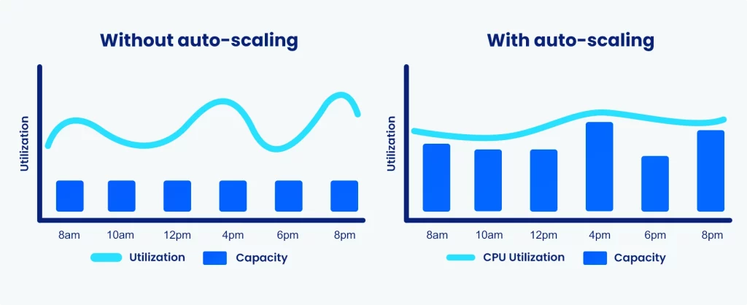

Slide 7
Types of autoscaling
Horizontal Scaling: Adding more instances of servers.
Vertical Scaling: Increasing the capacity of existing servers.
Scheduled Scaling: Based on a pre-defined schedule.
Dynamic Scaling: Based on real-time demand and monitoring.
Predictive Scaling: Uses machine learning to predict future traffic and scales resources in advance.
-
-

Slide 8

Introduction of loadbalancing
Load Balancing is the process of distributing incoming network traffic across multiple servers. This ensures no single server becomes overwhelmed, improving the availability and responsiveness of applications.
-
-

Slide 9

Importance of loadbalancing
Ensures high availability.
Improves performance and user experience.
Balances the load to prevent server overload.
Enables maintenance without downtime.
-
-

Slide 10
How loadbalancing works
Traffic Distribution: Directs incoming network or application traffic across multiple servers based on algorithms (e.g., Round Robin, Least Connections) to ensure no single server is overwhelmed.
Health Monitoring: Continuously checks the health and performance of servers, rerouting traffic away from any servers that are failing or underperforming.
Scalability Support: Works with auto scaling solutions to handle increasing traffic by distributing the load across newly added servers.
-
-

Slide 11
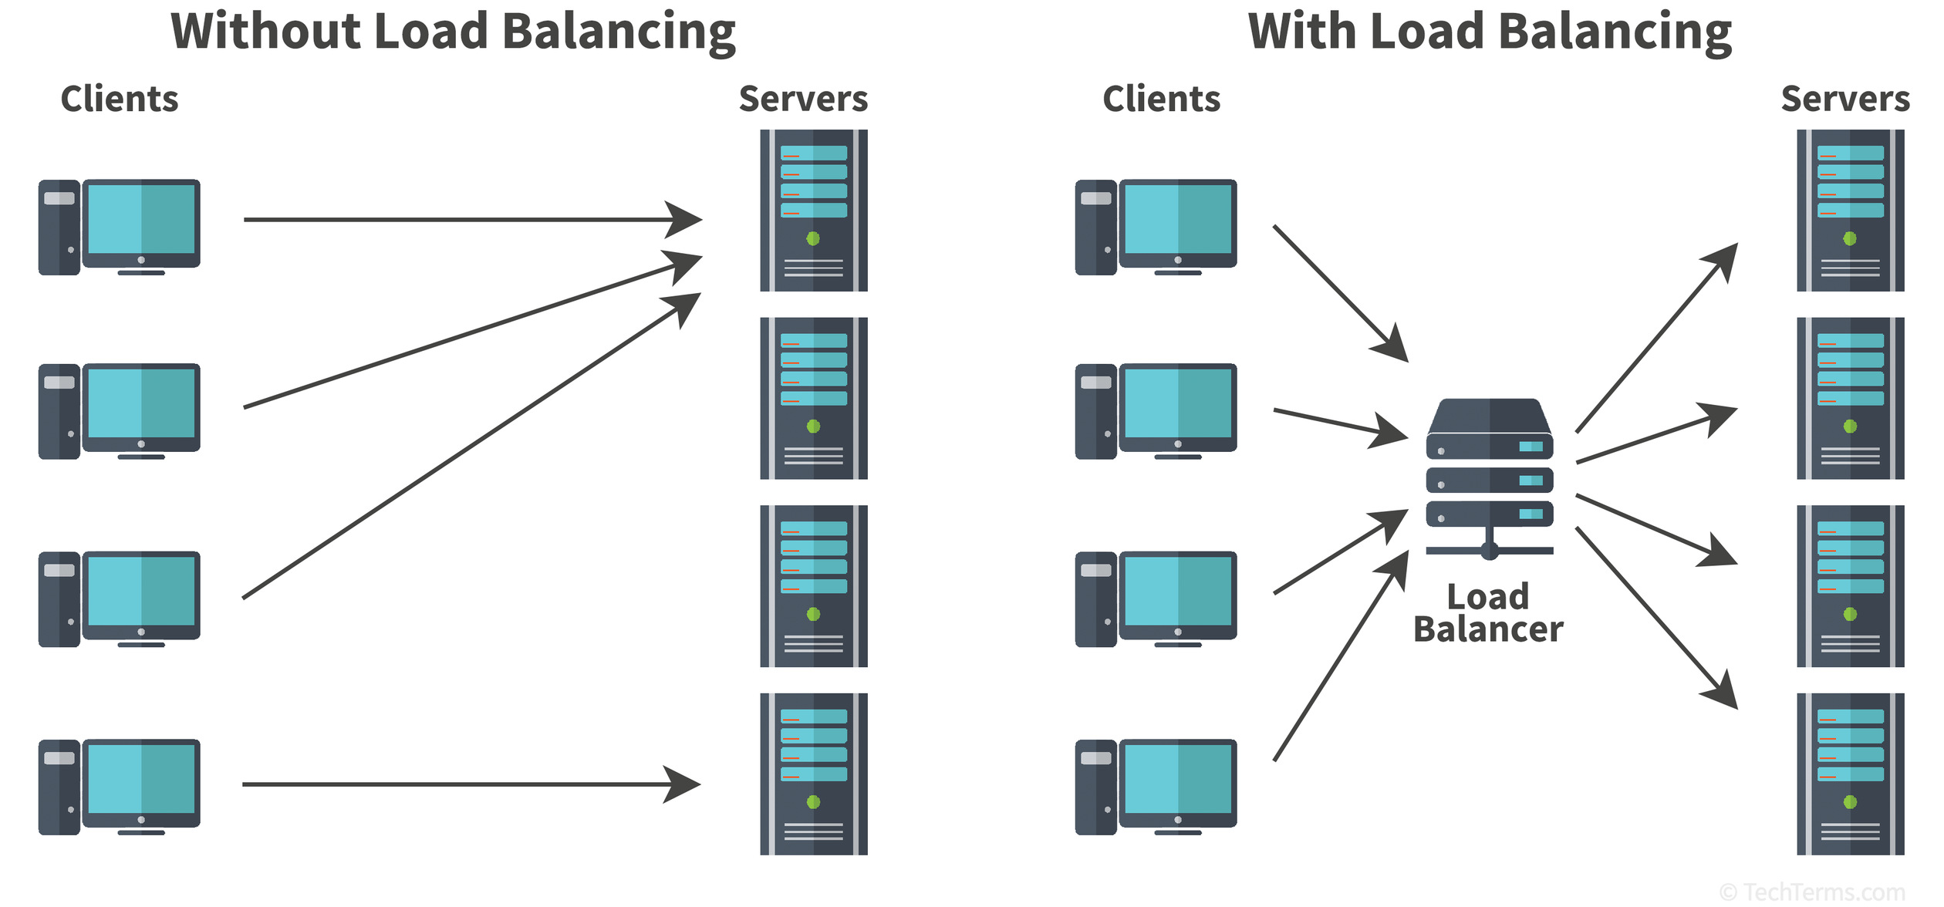

Slide 12
Types of loadbalancing
Layer 4 Load Balancing(Transport Layer): Operates at the transport layer (TCP/UDP).
Layer 7 Load Balancing(Application Layer): Operates at the application layer (HTTP/HTTPS).
Classic Load Balancer(CLB): It operates at both transport layer as well as at application layer
-
-

Slide 13
Thank
You
-
-

